Slide 1
Ethan Wells
Goals for the week
Train and test a CNN on the prepared LISA sign dataset.
Progress for the week
Trained and tested the LISA model: 89.90% top-1 (525 of 584 test crops) and 84.93% macro class accuracy.
Reviewed per-class results and found limited, uneven training data, including few independent sign tracks for several classes.
Sourced Mapillary data and prepared 3,449 crops for the same 12 classes: 2,655 train, 362 validation, and 432 test.
Goals for next week
Train and test a model on the prepared Mapillary data.
If time allows, combine the LISA and Mapillary datasets, then train and test the combined model.
Hours spent on progress: 7 hours
Notes:
Sources: Model Training/lisa_training_report.json; Model Training/README.md; Model Training/MAPILLARY_PREPARATION.md. Week 7 progress stops at Mapillary sourcing and data preparation.

Slide 2



LISA Model Results
Test recall by class (%)
Misclassified test crops
True: Merge
Predicted: Added Lane
Recall: 52.6% (10/19)
True: School
Predicted: Pedestrian Crossing
Recall: 63.6% (7/11)
True: Speed Limit 30
Predicted: Speed Limit 35
Recall: 71.4% (15/21)
Overall: 89.90% top-1 · 84.93% macro class accuracy
Test scores use prepared crops; they do not measure BuggyBot’s live camera pipeline.
Notes:
Source: Model Training/lisa_training_report.json. The chart shows test recall from 584 held-out crops. The three examples are errors from the held-out test split: Merge predicted as Added Lane, School predicted as Pedestrian Crossing, and Speed Limit 30 predicted as Speed Limit 35. The scores do not test live camera capture or sign detection.

Slide 3





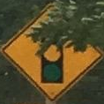



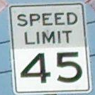
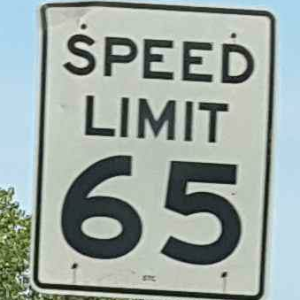

Mapillary Data Preparation
Prepared training crops · one example per class
Preparation
Sourced Mapillary road-scene images for the same 12 U.S. sign classes.
Prepared 3,449 cropped signs: 2,655 train, 362 validation, and 432 test.
Next: train and evaluate the model, then consider combining Mapillary with LISA.
Added Lane
Keep Right
Merge
Pedestrian
School
Signal Ahead
Speed 25
Speed 30
Speed 35
Speed 45
Speed 65
Stop
Notes:
Sources: Model Training/MAPILLARY_PREPARATION.md; Model Training/README.md. Gallery images are prepared Mapillary training crops, one example per class. The test set had not yet been used for a Mapillary model in the Week 7 reporting period.

